Slide 1

Engineering Case Studies (1)
Professor Bo Liu
James Watt School of Engineering

Slide 2

Microwave engineering: antenna design
What is the antenna?
An antenna is a component that is used to transmit or receive electromagnetic waves.

Slide 3
Antenna design—dipole antenna
What is the dipole antenna?
Dipole antenna is one of the earliest, simplest and most widely used antennas in radio communication.
The geometry parameters [l, r] of the antenna determine the performance of the antenna.

Slide 4
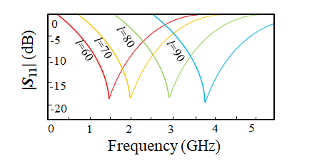
Antenna design—dipole antenna
Problem description
The geometry parameters [l, r] of the antenna determine the performance of the antenna, which can usually be adjusted/optimized during antenna design.

Slide 5
Antenna design—dipole antenna
Problem description
Design requirement: the magnitude of the antenna max (|S₁₁|) is less than -10 dB within the frequency range [1.8 GHz 2.2 GHz].
Search ranges: l is between 60 mm and 90 mm, and r is between 0.001 mm and 0.5 mm.

Slide 6
Antenna design—dipole antenna
How to formulate the problem into an optimization problem?
x=[l, r]
l∈[60 mm 90 mm]
r∈[0.001 mm 0.5 mm]
1. Find design variables
2. Establish the objective function
minimize max (|S₁₁(x)|) f∈[1.8 GHz 2.2 GHz]
3. Optimization problem formulation
minimize max (|S₁₁(x)|) f∈[1.8 GHz 2.2 GHz]
x=[l, r]
l∈[60 mm 90 mm]
r∈[0.001 mm 0.5 mm]

Slide 7




Thanks!
#UofGWorldChangers
@UofGlasgow

